Slide 1

Unsupervised Learning on Credit Approval Dataset
Prepared by: Himesh Chopra

Slide 2
C o n t e n t s
3 . D a t a
P r e p r o c e s s i n g
4 . F e a t u r e
D i s t r i b u t i o n
1 . I n t r o d u c t i o n
6 . C l u s t e r i n g
V i s u a l i z a t i o n s
2 . E D A
7 . P e r f o r m a n c e
E v a l u a t i o n M e t r i c s
8 . C o n c lu d in g
T h o u g h t s
5 . D i m e n s io n a it y
& M o d e l

Slide 3
I n t r o d u c t i o n

Slide 4
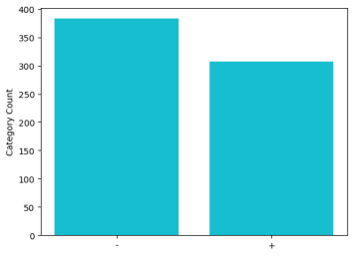
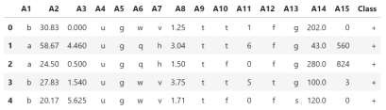
E x p l o r a t o r y D a t a A n a l y s i s :
U n d e r s t a n d i n g t h e D a t a
D a t a s e t O v e r v i e w
C l a s s D i s t r i b u t i o n
F e a t u r e T y p e s

Slide 5
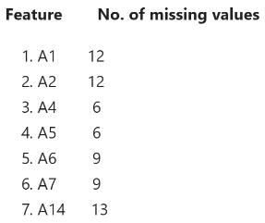
D a t a P r e p r o c e s s i n g : P r e p a r i n g f o r
U n s u p e r v i s e d L e a r n i n g
Missing Value Detection & Imputation
Outlier Detection & Removal
Label Encoding for Categorical Features
Visualizations for Feature Analysis

Slide 6
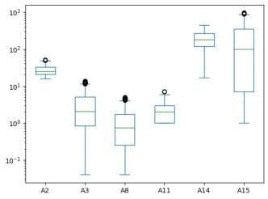
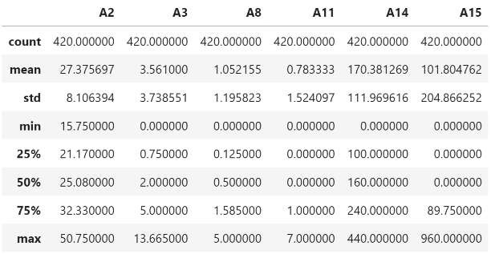
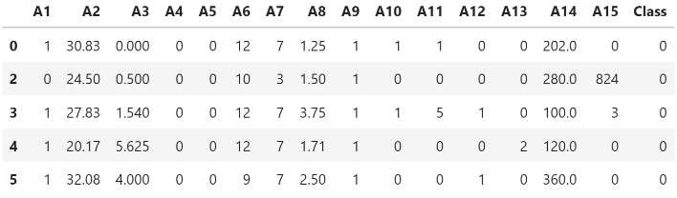

Slide 7
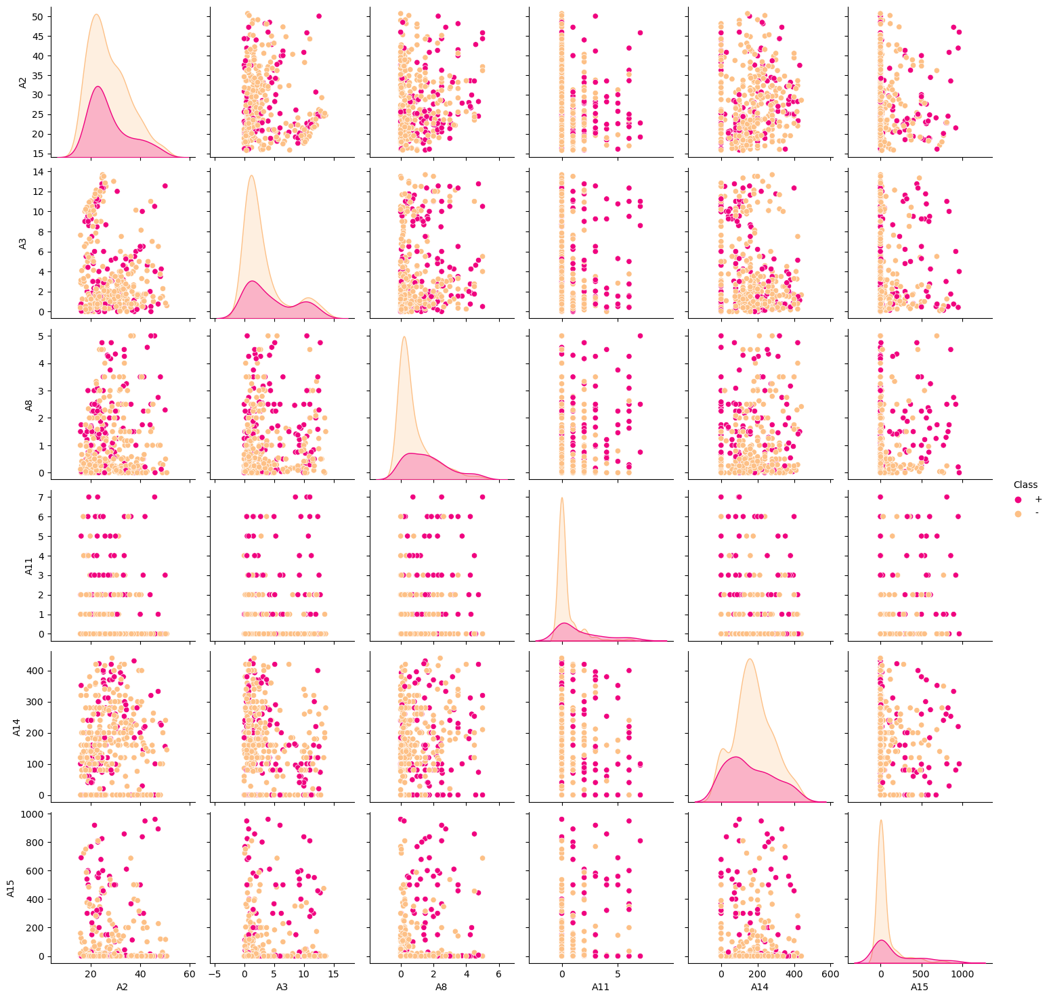

Slide 8
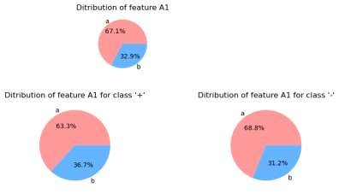
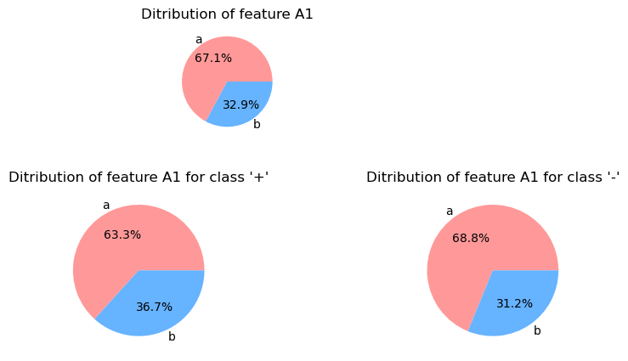
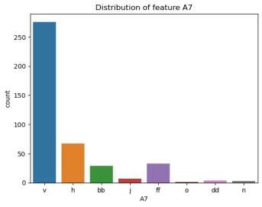
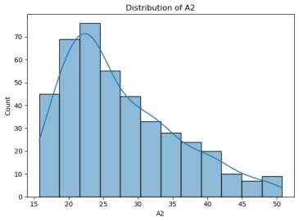



Slide 9
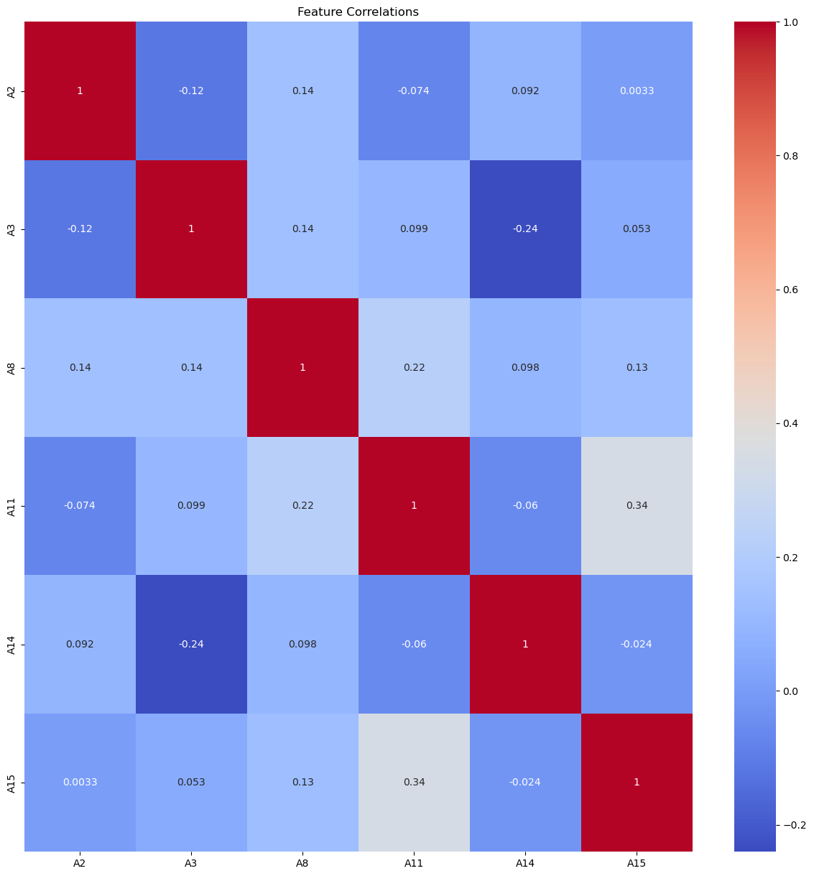

Slide 10
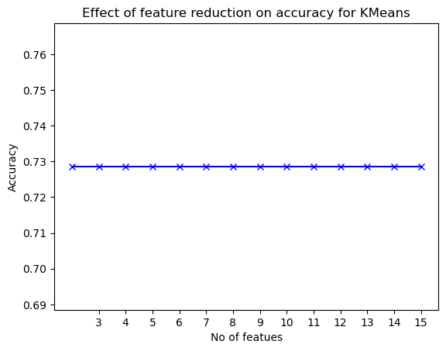
D I M E N S I O N A L I T Y R E D U C T I O N
& M O D E L S E L E C T I O N
Clustering Techniques Explored
Effect of Feature Reduction on Clustering Performance
Applying KMeans to the Full Feature Set
Clustering Visualizations
Outcomes

Slide 11
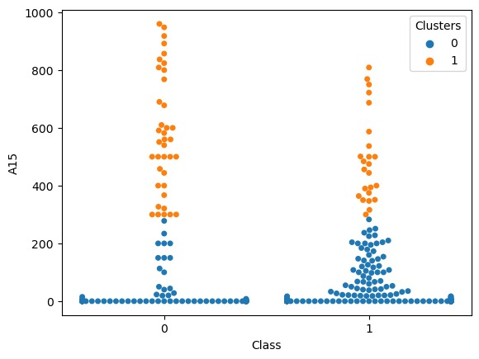
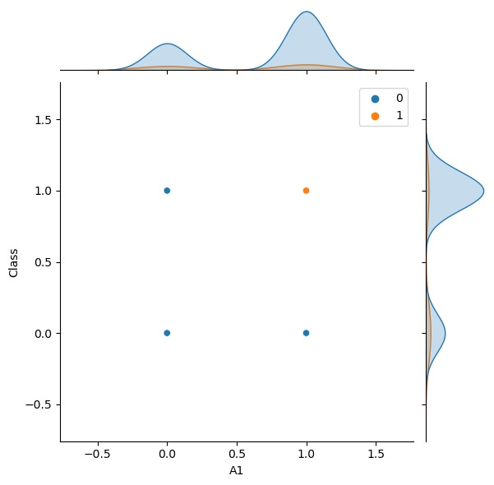
C l u s t e r i n g V i s u a l i z a t i o n s
Joint Plots
Swarm Plots
Benefits

Slide 12
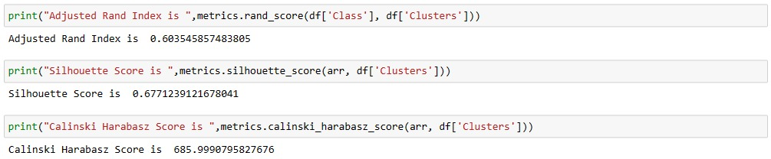
P e r f o r m a n c e E v a l u a t i o n M e t r i c s
S i g n i f i c a n c e &
I m p l i c a t i o n s

Slide 13
C o n c l u d i n g T h o u g h t s

Slide 14
T h a n k Y o u
Reference
Title: Credit Approval
Sources: (confidential)
Submitted by
quinlan@cs.su.oz.au Download link: https://archive.ics.uci
.edu/dataset/27/credit+
approval

